Slide 1
Smart Irrigation System (ESP32 + IoT + ML Prediction)
Presented by: Ajin Biju

Slide 2
INTRODUCTION
Develop an IoT-based irrigation system with ML-driven predictions.
Monitor and control irrigation via Blynk IoT dashboard.
Use machine learning models to forecast irrigation needs.

Slide 3
Workflow
Sensors (Soil + DHT11) collect live data.
ESP32 sends data to the Blynk cloud.
Stored data is used for ML model training (offline or cloud-based).
ML model (Random Forest) predicts irrigation need.
System automates pump control accordingly.

Slide 4
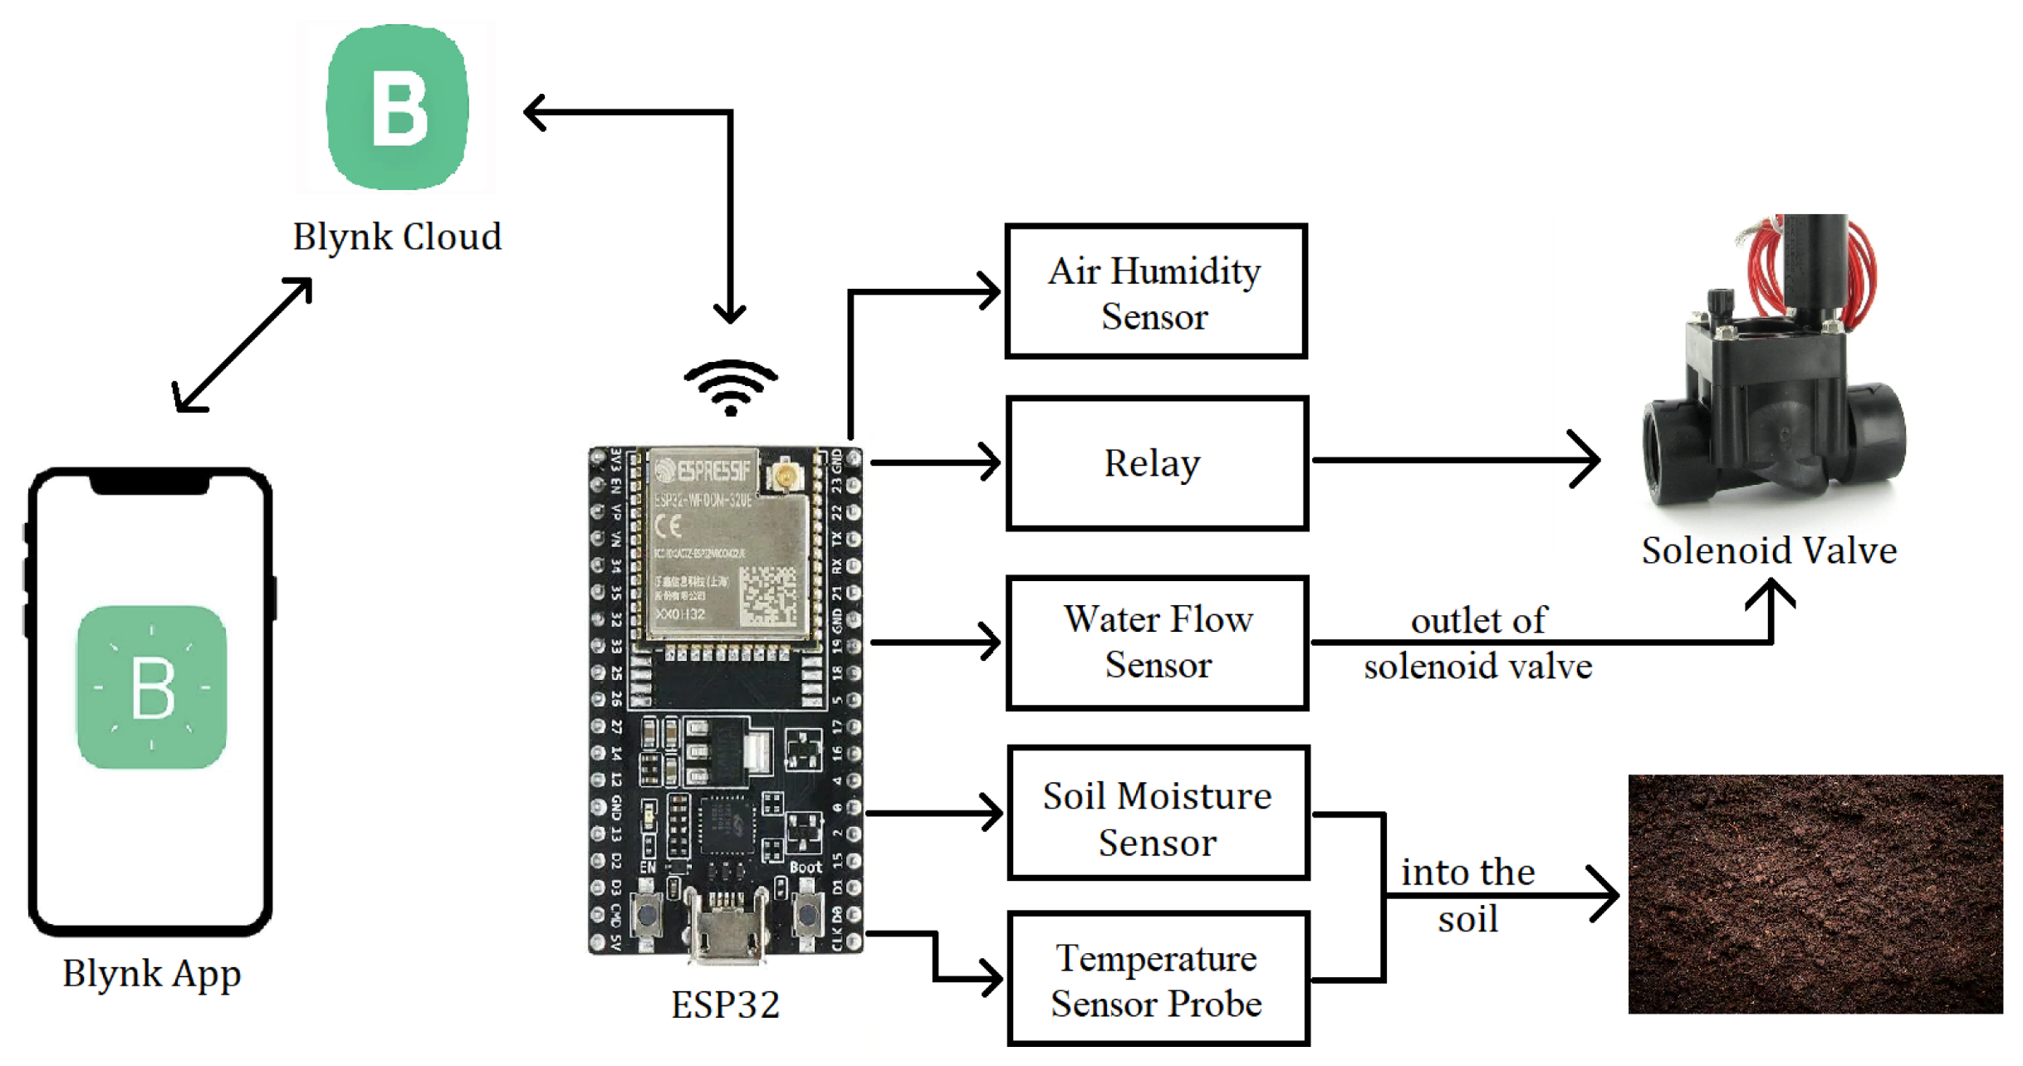

Slide 5
TECHNOLOGY STACK
Component | Technology
Microcontroller | ESP32
Sensors | DHT11, Soil Moisture
IoT Platform | Blynk IoT
Programming | Arduino IDE (C++)
ML Model | Python (Random Forest)
Libraries | Scikit-learn, Pandas, NumPy

Slide 6
MACHINE LEARNING MODEL
Algorithm Used: 🧩 Random Forest Regressor Reason for Selection:
High accuracy with small agricultural datasets.
Handles non-linear relationships between variables.
Resistant to overfitting and noise.

Slide 7
FEATURES USED FOR PREDICTION
Soil Moisture (%)
Temperature (°C)
Humidity (%)
Previous Irrigation Data

Slide 8
SAMPLE ML OUTPUT
Feature | Value | Predicted Soil Moisture | Action
Temp: 32°C | Humidity: 50% | 35% | Pump ON
Temp: 26°C | Humidity: 70% | 55% | Pump OFF
Accuracy: ~92% (using Random Forest on sample dataset)

Slide 9
BLYNK IOT DASHBOARD
Displays live sensor values (Soil, Temperature, Humidity).
Shows ML prediction results (e.g., irrigation need %).
Allows manual override of pump control.
Real-time updates via mobile app.

Slide 10
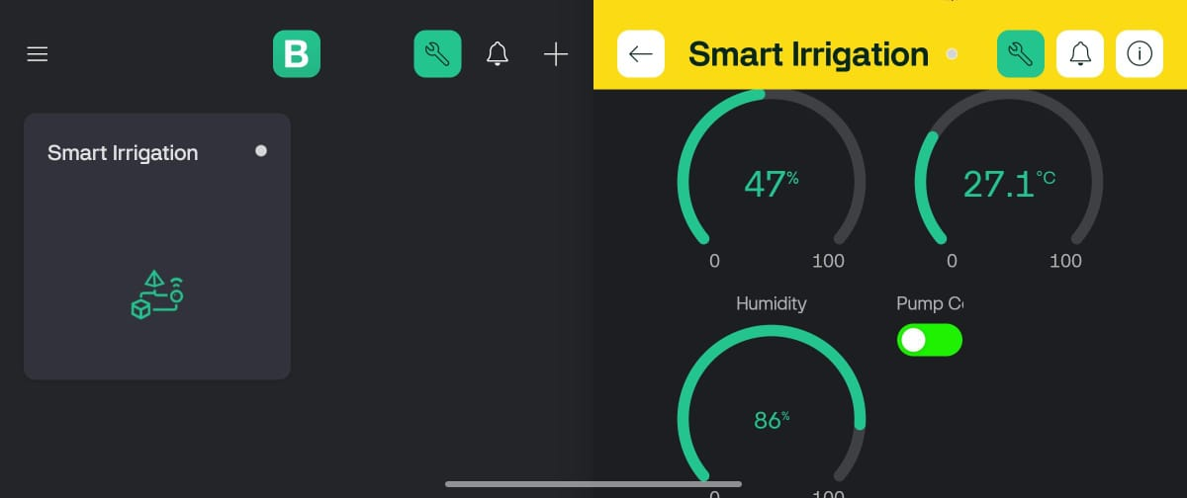

Slide 11
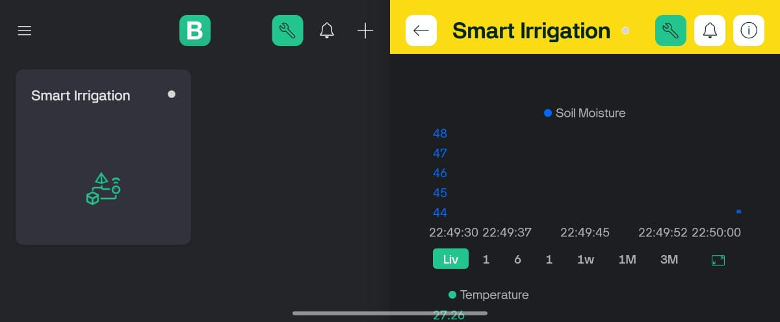

Slide 12
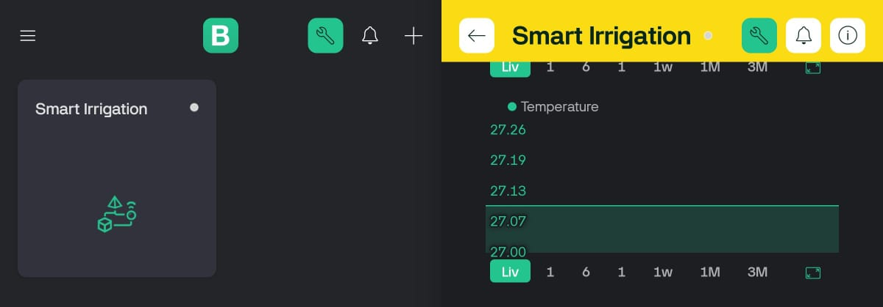

Slide 13
CONCLUSION
The Smart Irrigation System combines IoT + ML for intelligent
water management.
Real-time monitoring + predictive control ensures crop health and sustainability.
Reduces water waste and enhances efficiency in agriculture. A step toward AI-driven smart farming for the future.

Slide 14
THANKYOU…

